Slide 1
Pokémon Image Recognition
CS 5232 - Machine Learning and Data Mining
Group 3: Eric Nieters, Ritwik Raj Saxena, and Ibrahim Mamudu

Slide 2

Outline
Introduction
Proposed Work and Related Work
Implementations of algorithms
Datasets
Code Overview
Live Demo
Results
Conclusion
Source: https://pokecoord.com/pokemon-nests/

Slide 3
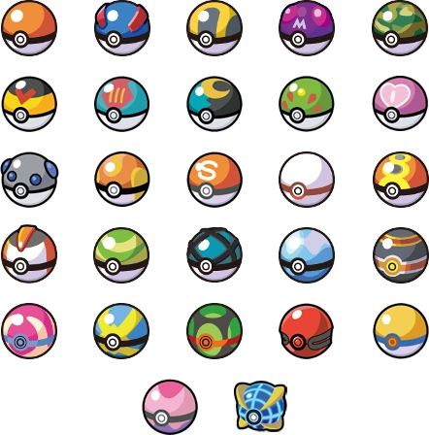
Introduction
The Problem:
Pokémon image recognition is uncommon.
Exiting models detect Pokémon, but provide no other information.
Most programs recognize few Pokémon.
The Solution:
Implement a website for detecting Pokémon.
Provides easier access than software.
Detect ⅔ of all currently existing Pokémon.
Source: https://nintendo.fandom.com/wiki/Poké_Ball

Slide 4

Introduction (Part 2)
Main algorithms (most accurate to least accurate):
Convolutional Neural Networks
Pre-trained Models
K-Nearest Neighbor
Support Vector Machines
Other Features:
Website implementation
Compare your image to the predicted Pokémon
Display stats of the predicted Pokémon
Analyze all of the stats of the predicted Pokémon
Source: https://projectpokemon.org/home/gallery/image/78446-charmanderpng/

Slide 5
Proposed Work
Supervised learning was used to train models.
Read in 10-20 images of each of 721 Pokémon.
Collect data, such as patterns, colors, number of pixels or size, depending on the model.
Store the model’s data and load it whenever a prediction is being made.
Developed in Python. Website uses PHP, HTML, CSS, JavaScript, and the Bootstrap framework.
Hosted on a virtual private server (VPS) with 4GB RAM, 150GB SSD Storage, 2TB Transfer.
All models are pre-trained. This reduces website load.

Slide 6
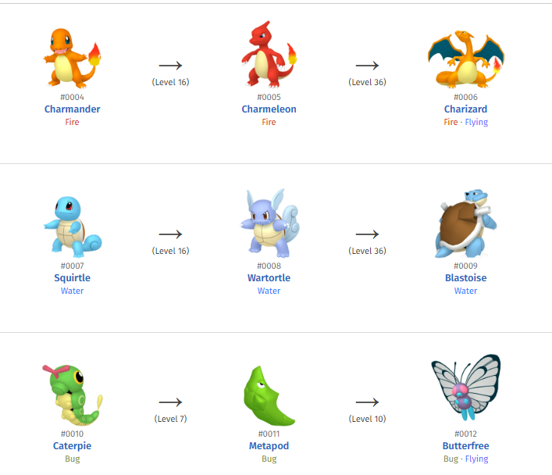
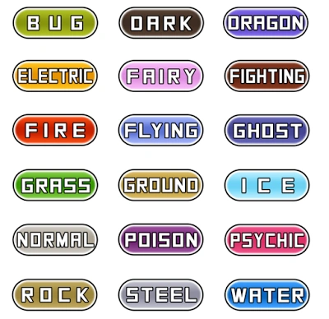
An Introduction to Pokemon
A pokemon is a fictional creature which is the basis for certain Japanese and Japan-inspired games and cartoons. It has stats, a type, a generation, and an evolution paradigm, as shown in the figure on the right. A list of the categories under which a pokemon can fall is as under:

Slide 7
Every Pokémon has an array of stats. These include:
HP (Hit Points) is a Pokémon's life force. If a Pokémon's HP hits zero, it faints and is no longer usable in battle (it can still use Hidden Machines, though).
The Speed stat decides which Pokémon will make the first move in battle. This stat can be critical in long battles.
Attack and Special Attack measure the strength of moves used by your Pokémon; the higher these are, the more damage the pokemon does to its opponents. Attack corresponds to moves in the Physical category, while Special Attack corresponds to Special moves.
Similarly, Defense and Special Defense measure the ability to take attacks from other Pokémon; the higher these are, the fewer hit points will be lost when attacked.

Slide 8
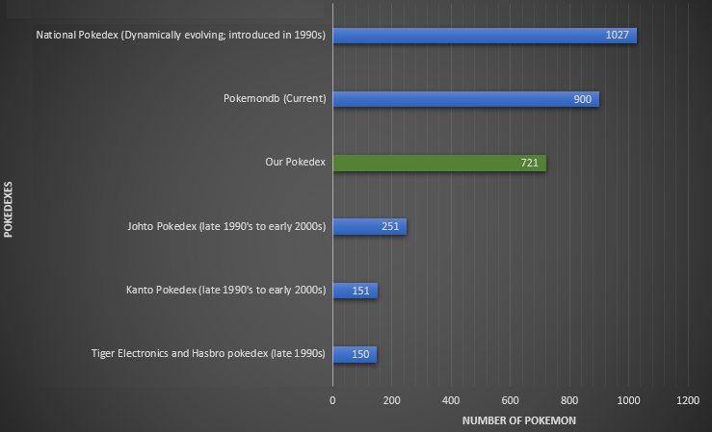
Comparison of Pokedexes

Slide 9
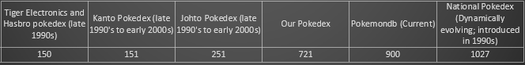
Uniqueness of Our Pokedex
The most comprehensive (possibly the only) pokedex to recognize and classify images based on supervised machine learning algorithms.
Even if we do not consider machine learning, it is one of the largest Pokedexes created.
Gives information about 721 Pokemon belonging to 6 generations
Since we had to train machine learning algorithms on pokemon images, we needed sufficient number of images for each pokemon; the images of pokemon from seventh to ninth generations were not readily available.
Therefore, we built a pokedex with the first six generations of pokemon
Trained over 10,000+ images
Notes:
A user who goes by the handle Code AI gives a step-by-step description of how they used CNN for Pokémon image recognition [3]. They have used Vishal Subbiah’s Pokémon Image Dataset from Kaggle [4].
Chirra et al, in their recent research paper have used transfer learning to classify Pokémon images [5]. They have created an index of Pokémon which they term Pokepedia. Their ResNet101 pre-trained model gave the best accuracy when measured against the rest of their models [5].
Chu et al. presented their work attribute prediction in Pokémon images using CNNs at the 2nd International Conference on Electrical Engineering, Big Data and Algorithms (EEBDA) in China [6]. They have used CNN to classify the attributes of Pokémon. Their algorithm can determine the number of Pokémon belonging to a specific type (fire, water, grass, bug etc.) in their dataset consisting of images of 802 Pokémon. They utilized the images of the Pokémon obtained from a scorching game branded as Pokémon as their dataset [6]. They crafted a CNN algorithm harnessed it for type classification from the images in their dataset before they enhanced (preprocessed) their data (Pokémon images) and ran another iteration of CNN on it to improve their results [6]. However, their algorithm cannot determine any other statistic of a Pokémon, including the generation or even the name. This gives it serious limitations compared to the work that we propose.

Slide 10
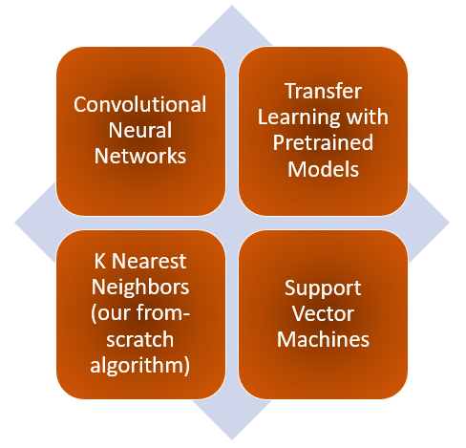
The algorithms we used

Slide 11
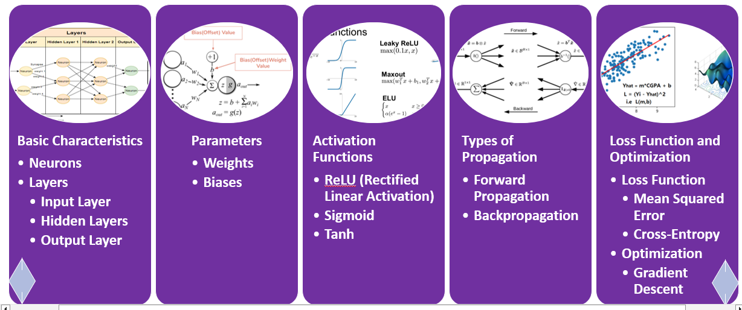
An overview of Neural Networks

Slide 12
Convolutional Neural Networks (CNN)
Each layer performs convolutions on images
Convolutions enable the architecture to extract features from each image exhaustively.
CNNs are usually deep to very deep architectures, depending on the number of convolution operations involved. Usually higher the number of convolutions, better is the feature extraction, and better is the prediction power of the model
They are usually used as the pretrained models as well as the new classifiers in a Transfer Learning setup for object or image classification.

Slide 13

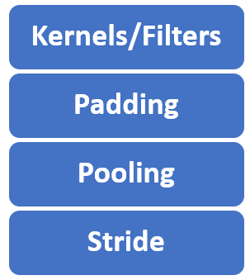
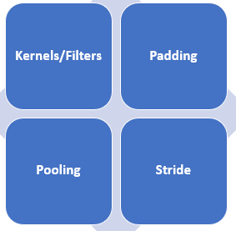
Distinctive Features of Convolutional Neural Networks (CNN)
Notes:
In image processing, a kernel, convolution matrix, filter, or mask is a small matrix used for blurring, sharpening, embossing, edge detection, and more. This is accomplished by doing a convolution between the kernel and an image. Or more simply, when each pixel in the output image is a function of the nearby pixels (including itself) in the input image, the kernel is that function.
Padding is a critical technique used to manage the spatial dimensions of input data. Padding is the process of adding layers of zeros or other values outside the actual data in an input matrix. The primary purpose of padding is to preserve the spatial size of the input so that the output after applying filters (kernels) remains the same size, or to adjust it according to the desired output dimensions.
Output feature maps are sensitive to the location of the features in the input. One approach to address this sensitivity is to downsample the feature maps. This has the effect of making the resulting downsampled feature maps more robust to changes in the position of the feature in the image, referred to by the technical phrase “local translation invariance.”
Pooling layers provide an approach to down sampling feature maps by summarizing the presence of features in patches of the feature map. Two common pooling methods are average pooling and max pooling that summarize the average presence of a feature and the most activated presence of a feature respectively.
Stride is a parameter that dictates the movement of the kernel, or filter, across the input data, such as an image. When performing a convolution operation, the stride determines how many units the filter shifts at each step. This shift can be horizontal, vertical, or both, depending on the stride's configuration.
For example, a stride of 1 moves the filter one pixel at a time, while a stride of 2 moves it two pixels. A larger stride will produce a smaller output dimension, effectively downsampling the image.

Slide 14
We used Convolutional Neural Networks for image classification because
They were created specifically for image classification; they efficiently recognize patterns from the images.
They focus on efficacious color recognition and different color planes
They minutely track extremely critical features, like edges, on each image to produce an immensely precise prediction.

Slide 15
For our CNN implementation, we have used the InceptionResNetV2 model. It:
Is coded in the Keras package within the TensorFlow library of Python.
Is a pretrained model trained on Imagenet dataset
Uses the Inception family of architectures, created by Google
Integrates Inception model with the idea of residual connections (ResNet).
Is described as a very deep architecture
Was developed with the aim to enhance algorithmic performance, primarily in image detection, classification, processing and prediction.

Slide 16
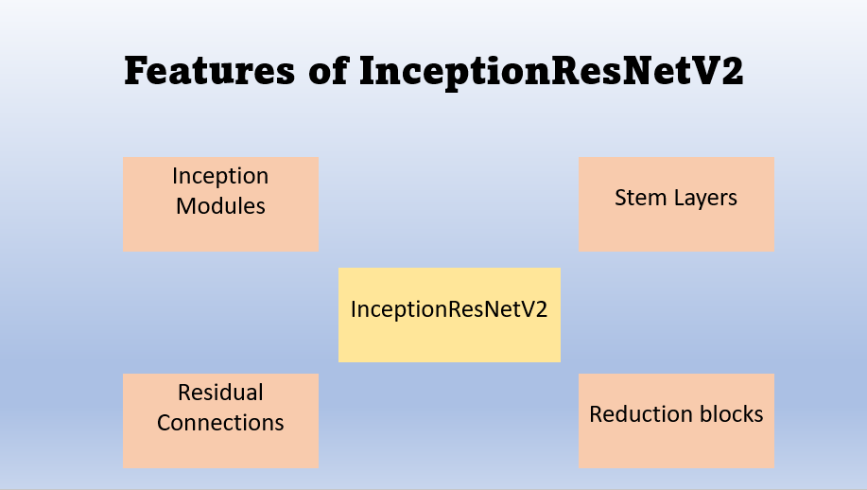
Notes:
The key components of InceptionResNetV2 include:
Inception modules, which consist of multiple parallel convolutional pathways of different kernel sizes (1x1, 3x3, 5x5, etc.) and pooling operations. These modules enable the model to learn the features of images at multiple scales.
Residual connections: Borrowing the best features of the ResNet architecture, InceptionResNetV2 includes residual connections which are also referred to as skip connections. These connections allow the flow of information through the network by adding shortcuts that bypass some layers, which in turn helps in relieving the vanishing gradient problem, facilitating the training of deep neural networks.
Stem layers: The beginning layers of the network, which are named stem layers, are involved in processing input images, and extracting basic features. These layers consist of convolutional, pooling, and normalization operations. They are common to all CNNs, including Inception-ResNet-V2.
Reduction blocks: Interspersed within the architecture are reduction blocks that reduce the spatial dimensions of the feature maps, helping to decrease computational burden while retaining important information.

Slide 17
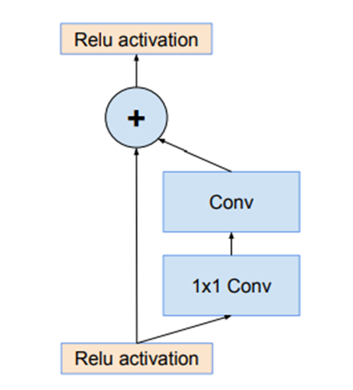
A simplified version of a ResNet Connection
Notes:
1. ReLU activation: This function returns zero for any input less than zero and returns the input as is for any positive input.
1x1 Convolution (Conv1x1): This operation involves a convolutional layer with a kernel size of 1x1. A 1x1 convolution operates along the channel dimension and can be used to adjust the depth of the feature maps, which helps in combining and transforming features. Traditional convolutions involve larger kernels.
Pooling can be used to down sample the content of feature maps, reducing their width and height whilst maintaining their salient features.
A problem with deep convolutional neural networks is that the number of feature maps often increases with the depth of the network. This problem can result in a dramatic increase in the number of parameters and computation required when larger filter sizes are used, such as 5×5 and 7×7.
To address this problem, a 1×1 convolutional layer can be used that offers a channel-wise pooling, often called feature map pooling or a projection layer. This simple technique can be used for dimensionality reduction, decreasing the number of feature maps whilst retaining their salient features. It can also be used directly to create a one-to-one projection of the feature maps to pool features across channels or to increase the number of feature maps, such as after traditional pooling layers.
Convolutional Layer (Conv): This typically refers to a standard convolutional layer that involves applying a filter/kernel to the input feature maps. The filter moves across the input, performing element-wise multiplications and summing up the results to produce the output feature maps.
Addition (+): This operation suggests an element-wise addition or summation. It's likely used to combine the output of the previous convolutional layers or feature maps obtained from different pathways within the network.
ReLU activation (Post-Addition): This ReLU activation function is applied after the addition operation, introducing non-linearity to the combined feature maps obtained from the previous operations.
In the figure, the arrow that goes from the input ReLU to the + node is a residual connection.

Slide 18
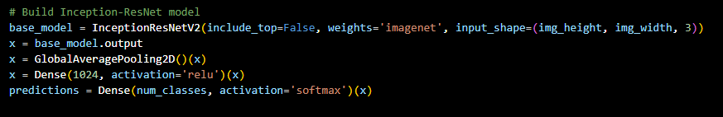
Our InceptionResNetV2 Model uses four layers:
InceptionResNetV2 Base Model:
InceptionResNetV2 is a deep CNN architecture combining the Inception architecture with residual connections.
This first line of the code creates the base model using InceptionResNetV2 with the following settings:
include_top=False: Excludes the fully connected layers at the top of the network, allowing for custom additional layers.
weights='imagenet': Initializes the model with weights pre-trained on the ImageNet dataset.
input_shape=(img_height, img_width,3): Specifies the input image shape (height, width, channels) for the model.
Global Average Pooling Layer:
GlobalAveragePooling2D(): This layer performs global average pooling over the spatial dimensions of the input tensor.
Reduces each feature map to a single value by averaging all values in the feature map, providing a fixed-size output.
Dense Layer (with ReLU Activation):
Dense(1024, activation='relu'): Adds a fully connected layer with 1024 units and ReLU activation function.
This layer performs a linear transformation on the incoming data followed by an element-wise ReLU activation function.
It introduces non-linearity to the network and helps learn complex patterns in the data.
Output Dense Layer (with Softmax Activation):
Dense(num_classes, activation='softmax'): Adds the final dense layer with num_classes units (representing the number of classes in the classification task) and a softmax activation function.
Softmax activation calculates class probabilities for multi-class classification, providing the probability distribution over the classes.
Notes:
InceptionResNetV2 comprises various blocks, including convolutional layers, residual blocks, and Inception modules. The number of layers excluded when setting include_top=False will generally consist of the dense layers responsible for classification, typically a global average pooling layer followed by fully connected dense layers. We dropped these and added our own Global Average Pooling Layer and Dense Layer with ReLU architecture.

Slide 19
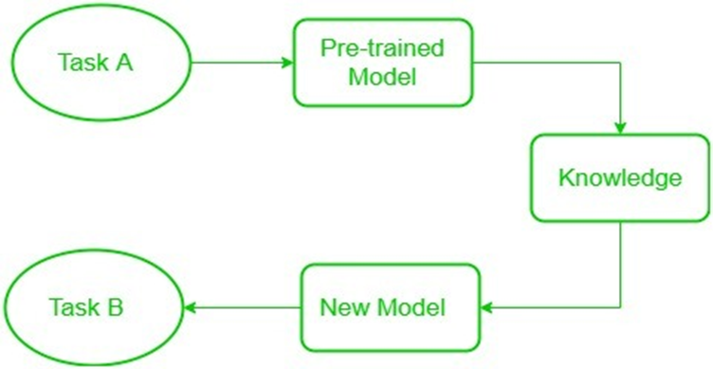
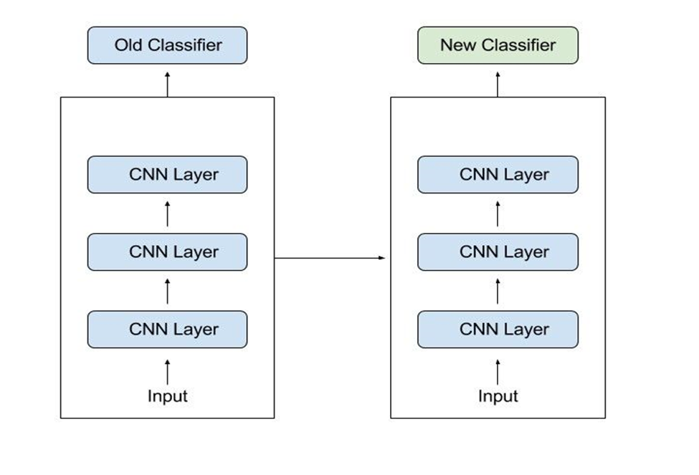
Transfer Learning with Pre-Trained Models
The above figure displays the basic schematics of transfer learning while the figure on the right sows how transfer learning with pretrained model as well as the new classifier being convolutional neural networks.
Notes:
Transfer Learning can be done in two ways:
By extending the pretrained model: In this approach, we leave the pretrained model untouched. This is pure Transfer learning and is used by our Transfer Learning model. Extending a Pretrained Model:
Adding New Layers on Top: In this approach, new layers are added on top of the existing pre-trained model, keeping the pre-trained layers frozen (not trainable). These added layers are typically used for task-specific fine-tuning or classification.
Feature Extraction: The pre-trained layers act as feature extractors, capturing generic patterns and high-level features from the original dataset they were trained on (e.g., ImageNet).
Customization for New Task: By adding new layers on top, these additional layers learn to interpret the high-level features extracted by the pre-trained layers and adapt them for the specific nuances of the new dataset or task. These new layers are usually trained from scratch while leveraging the pre-trained feature extraction capabilities.
Adjusting a Pretrained Model (Fine-tuning): This is better termed fine-tuning instead of transfer learning. Our InceptionResNetV2 used this.
Unfreezing and Modifying Existing Layers: In this approach, some of the existing layers in the pre-trained model are unfrozen, allowing them to be further trained (fine-tuned) on the new dataset while also adding new layers on top.
Relearning Task-Specific Features: The fine-tuning process involves updating the weights of both the newly added layers and selected layers from the pre-trained model. This allows the network to adapt not only to the new task but also to adjust some of its previously learned representations to better suit the new data.
Balance of Learning Rates: Typically, lower learning rates are applied to the pre-trained layers that are being fine-tuned, allowing them to adapt gradually without forgetting the learned representations, while higher learning rates are used for the new layers added on top.
Use Case: Fine-tuning is often applied when the new dataset is relatively larger and more similar to the original dataset used for pre-training, allowing the network to leverage both the general and specific features learned from the original dataset.

Slide 20
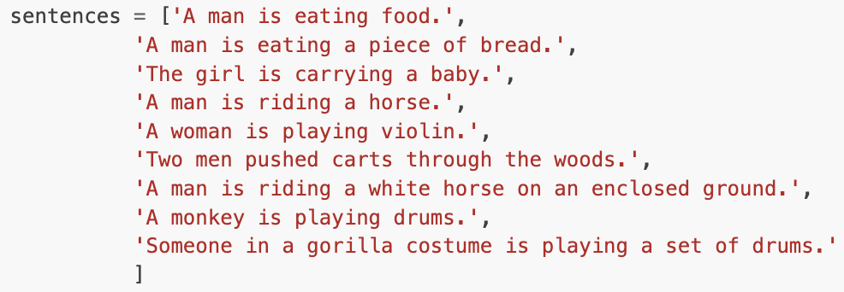
Transfer Learning with Pre-Trained Models
Our transfer learning utilizes the library called SentenceTransformers
A library for sentence, text and image embeddings.
Similar to “implementing Google” using your own detected vocabulary.
Works with multiple languages.
Detects over 1,000,000,000+ pairs by using a 256 dimension vector field that can plot images and sentences near each other.
K-Nearest Neighbor on steroids.
Can detect the top five most similar pairs of sentences:

Slide 21

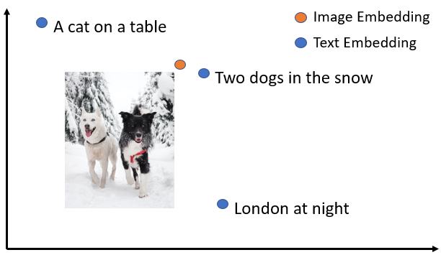

Slide 22

K-Nearest Neighbor
Our “from scratch” algorithm which uses no machine learning libraries.
All images of Pokémon get converted into an array that counts the number of times that 256 total colors appear in each image.
Euclidean Distance is measured between the tested Pokémon and every single Pokémon image in the dataset.
The “shortest” distance between the trained set and the tested Pokémon is stored in ranking order.
The most difficult algorithm to implement for our project!
Source: https://pngimg.com/image/27696

Slide 23
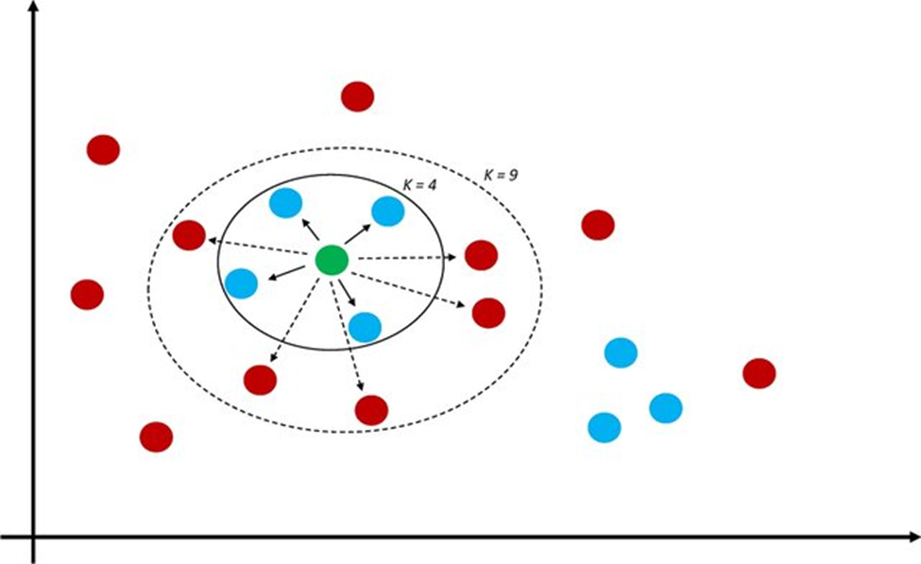
K-Nearest Neighbor
An instance of the k-nearest neighbor machine is shown in this figure.
The classes are catalogued based on their feature values.
The classification of a member belonging to one of the classes is determined by a majority vote in the member’s neighborhood.
The number k is the number of neighbors that will be used to classify the member. They are the ones that most closely resemble the member to be classified.
The choice of k is crucial to classification. For example, if it is needed to classify the green member based on k = 3, the member would be placed alongside the blue members. If k = 9 is chosen, the member would be placed alongside the red members.
Source: Musolf, A. M., Holzinger, E. R., Malley, J. D., & Bailey-Wilson, J. E. (2021). What makes a good prediction? Feature importance and beginning to open the black box of machine learning in genetics. Human Genetics, 141(9), 1515–1528. https://doi.org/10.1007/s00439-021-02402-z

Slide 24

Support Vector Machines (SVM)
SVMs aim to find the optimal hyperplane to separate different classes while maximizing the margin between the closest data points (support vectors).
They are not very well suited to image recognition as they are to tabular datasets, but in the beginning of the course, while deciding what algorithms we would use, we did not know this.
Despite its limitations, we kept it as one of our models feeling that demonstrating its weakness with image classification and detection would be a learning opportunity, not only for us but also for others.
We also worked hard to improve its accuracy to the utmost we could. A project must involve challenges to be called a true project and this was one of our challenges.
Source: https://www.stickpng.com/img/games/pokemon/bulbasaur-pokemon

Slide 25
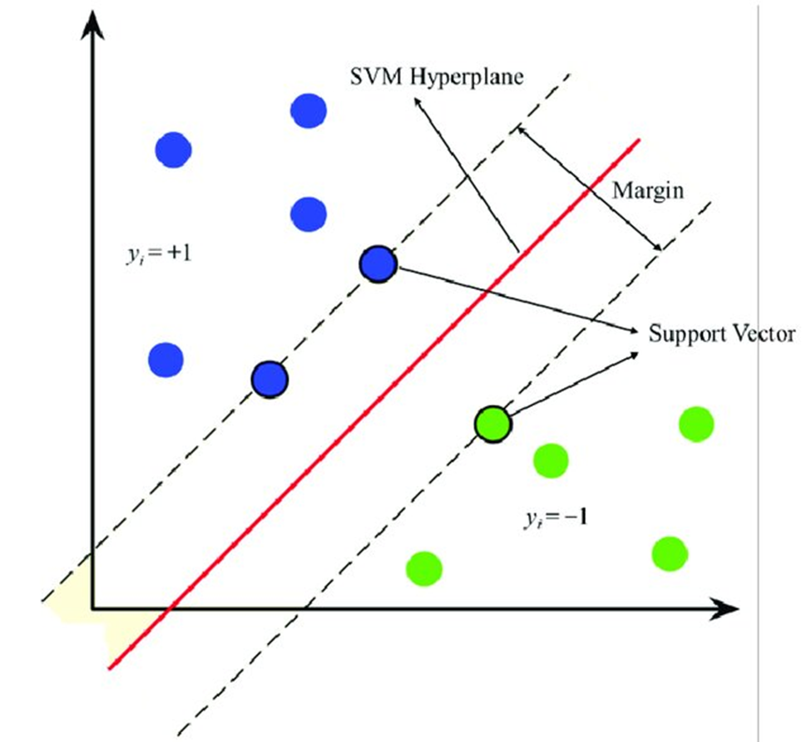
Support Vector Machines (SVM)
The figure on the right shows how support vector machines work.
Source: Yang, I., & Prayogo, H. (2022). Efficient Reliability analysis of structures using symbiotic organisms Search-Based Active Learning Support Vector Machine. Buildings, 12(4), 455. https://doi.org/10.3390/buildings12040455

Slide 26
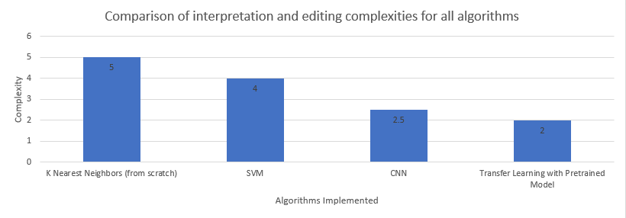
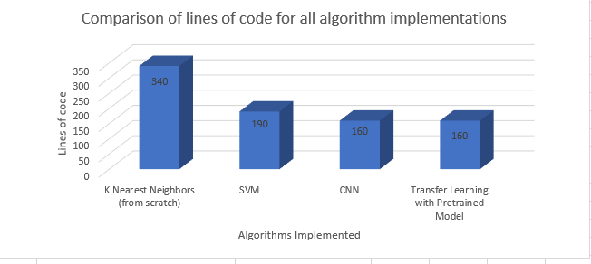
Comparison of Intricacy of our Algorithms
Notes:
We were intending to implement Precision, Recall, F1 Metric and to calculate the area under Reciever Operating Curve for our algorithms for generation of more stats and plots, but the decision was taken after the algorithms had been implemented. The high complexity of some and the constraints of not using machine learning libraries with at least one of the programs hampered our goal to implement those metrics.

Slide 27
Datasets
Image data:
Generated by us.
Originally contained 14,420 images.
4,370 images removed by hand that were bad data.
Images with detailed background, had props, multiple Pokémon in one image, etc.
Used BingImageDownloader in Python.
Pokémon statistical data:
Generated by alopez247 on Kaggle.
Contains 721 Pokémon from generations 1 through 6.
Each entity has 21 attributes.
Details range from stats from the games to the type of egg that it’s hatched from.
21 years worth of information.
All displayed on the website.
Source: https://www.kaggle.com/datasets/alopez247/pokemon

Slide 28
Code Overview (Pre-Trained)

Slide 29
Code Overview (K-NN)

Slide 30
Code Overview (SVM)

Slide 31

Demonstration
How to Access:
Visit https://www.pokemonimagerecognition.com
Google “pokemon image recognition” and find our website on the first page.
For accuracy, it’s recommended to use the CNN algorithm!
Source: https://www.pinterest.com/pin/742953269760209829/

Slide 32
Results

Slide 33
Conclusion

Slide 34
Questions?

